Slide 1


report speech emotion recognition
ALI QAMBARI
ISFAHAN UNIVERSITY OF TECHNOLOGY

Slide 2

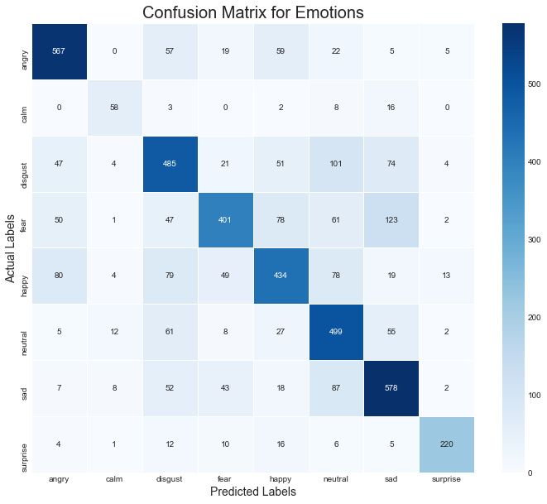
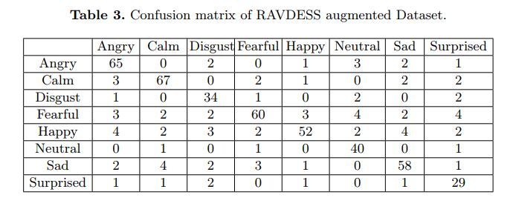
Training 1D-CNN: Injecting noise
Augmentation in the audio database usually generates additional audio files by applying some special operation on the original database, such as injecting noise, adjusting pitch, changing vocal tract, adjusting speed, etc. In the following article, all of the files are augmented with injecting noise:
Speech emotion recognition in neurological disorders using Convolutional Neural Network Sharif Noor Zisad
Noise/
Aug.
ONLY RAVDESS:
training Accuracy: 93.7%
testing Accuracy: 82.5%
SAVEE + TESS+ RAVDESS+ CREMA-D:
training Accuracy: 90.72%
testing Accuracy: 66.64%
1 - 5

Slide 3
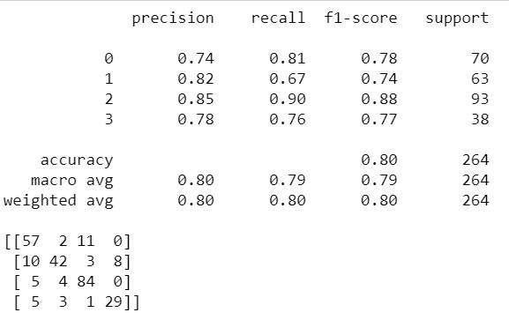

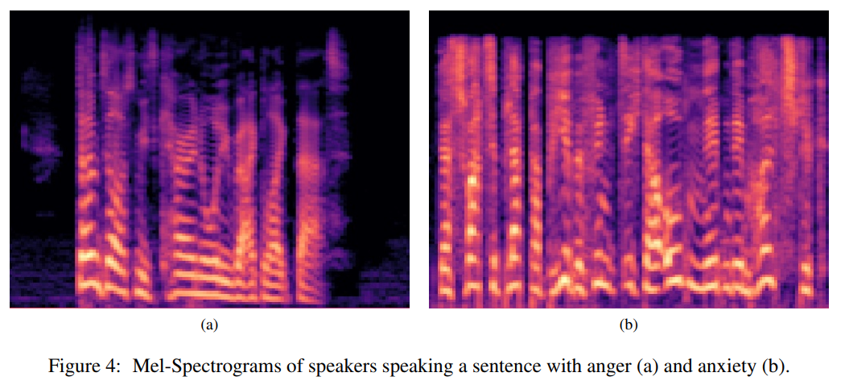
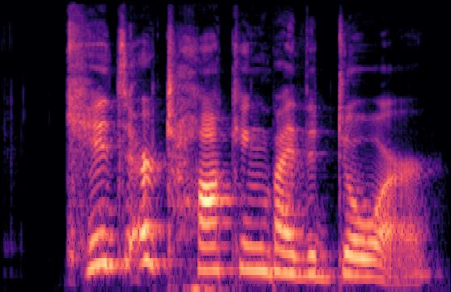
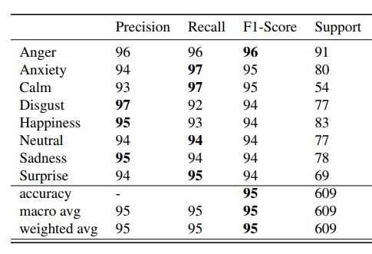
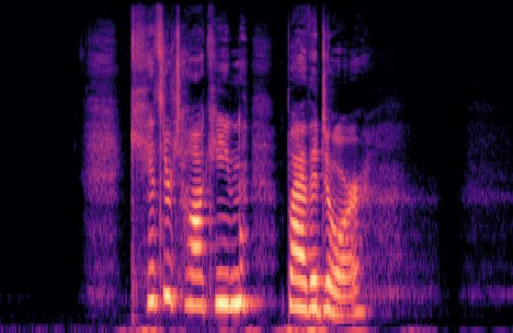
2D-CNN / AUDIO TO SPECTROGRAM
FSER: Deep Convolutional Neural Networks for Speech Emotion Recognition Bonaventure F. P. Dossou / Jacobs University, Germany Yeno K. S. Gbenou / Drexel University, USA
Data: Emodb, Emovo, Savee, RAVDESS.
2D
CNN
DATASET: RADVESS
Different params.
EMOTIONS = {
"angry",
"sad",
"neutral",
"happy"
}
2 - 5

Slide 4
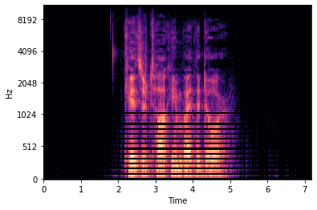
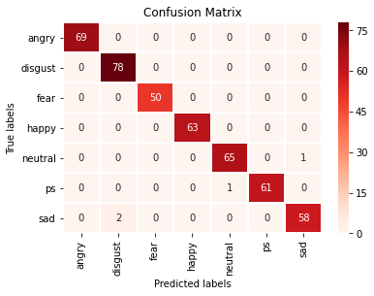
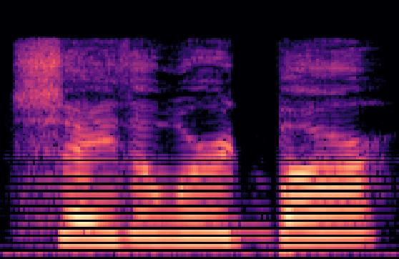
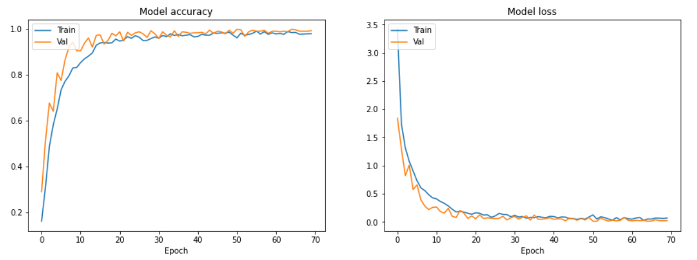
2D-CNN / AUDIO TO SPECTROGRAM
TESS DATASET: USING EXACTLY THE SAME PARAMS. FOR GENERATING SPECS.
DATA AUGMENTATION:
zoom_range=0.1,
width_shift_range=0.1,
height_shift_range=0.1,
h-flip
2D
CNN
NOISE REDUCTION + TRIMMING
3 - 5

Slide 5
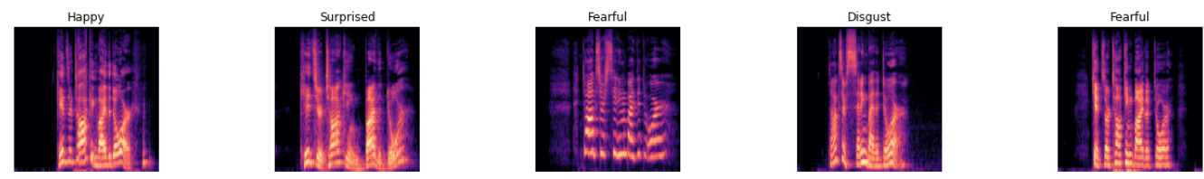
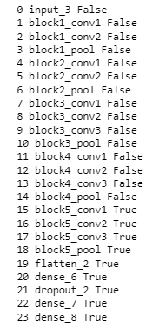
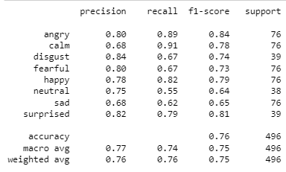
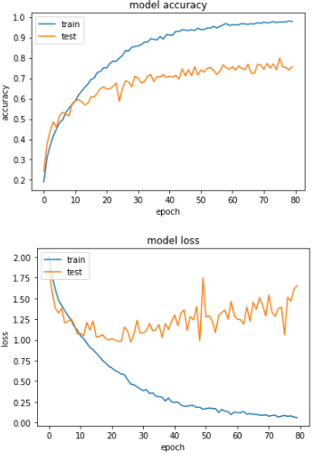
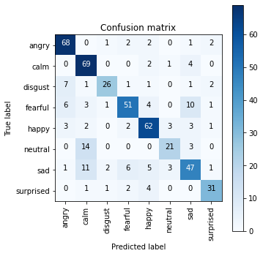
Transfer Learning – RAVDESS + DATA AUG.
vgg_model = VGG16(weights='imagenet',
include_top=False,
input_shape=(224, 224, 3))
Transfer
learning
4 - 5

Slide 6
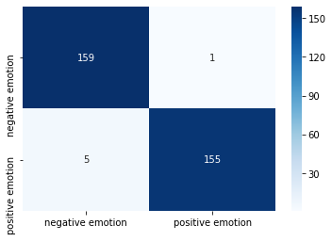
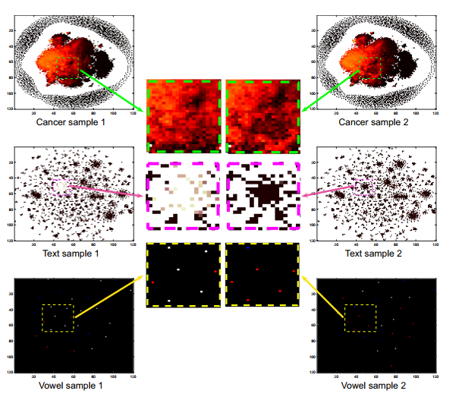
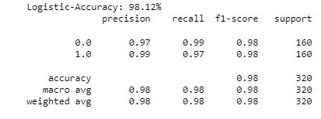
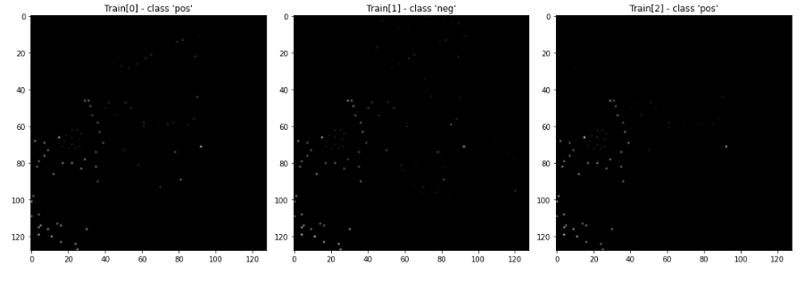
Deep Insight / A_F(NEG) VS. H_S(POS)
DATASET: TESS
The train accuracy was 0.991
The test accuracy was 0.981
Deep
Insight
5 - 5

Slide 7
Thanks

